Slide 1








Recommended Plan: Mcnary pit design concepts
McNary Spillway PIT Improvement PDT
USACE Walla Walla District
16 July 2025

Slide 2
Agenda
2:00-4:00pm
Introductions
Status of Project: Recommended Plan
Overview of Screening Criteria and Ranking
Alternative Comparison
Recommended Plan
Next Steps and Open Discussion

Slide 3
MCN PIT DETECTION PROJECT DELIVERY TEAM
Walla Walla District Office:
Kathryn Herzog- Project Manager
Andrew Glencross- Electrical – Eng Technical Lead
Travis Foster- Hydraulics
Jana West- Civil
Brandon Tewell- Structural
Ryan Laughery- Hydraulics
Brent Meachum- Mechanical
Tiffany Stoeckig-Dixon- Operations Fisheries
Chris Peery- Operations Fisheries
Chuck Barnes- Fish Biologist
Ryan Ashcraft- Fish Biologist
McNary Dam:
Martin Ahman- Chief of Tech
Bobby Johnson- Fisheries
Paul Bertschinger - Fisheries
Talon Adkins- Electrical
Anthony Ohare- Mechanical
PSMFC:
Gordy Axel
Mark Leonard
Darren Chase
Scott Livingston
NOAA: TBD

Slide 4
Constraints and Screening criteria
Constraints:
Prototype must fit within existing infrastructure
Prototype cannot hinder fish passage by obstructing passage route
Prototype cannot impede emergency spilling requirements
Prototype cannot impact dam structure or operations required for safety, passing debris, or regular/continued maintenance
Prototype must be based on technology that either exists or could exist by time of construction
Criteria:
Detection Delta (2.0)
Durability and Robustness (1.7)
Routine O&M (1.7)
Constructability (1.4)
Hydraulics (1.1)
Fish Behavior (1.3)
Cost (1.6)
Research and Development (1.3)

Slide 5
Alternative Comparison:
See Alternative Worksheet
-Alternatives 1, 2, 3, and 7 screened due to violation of constraints and/or reduction in flow capacity

Slide 6
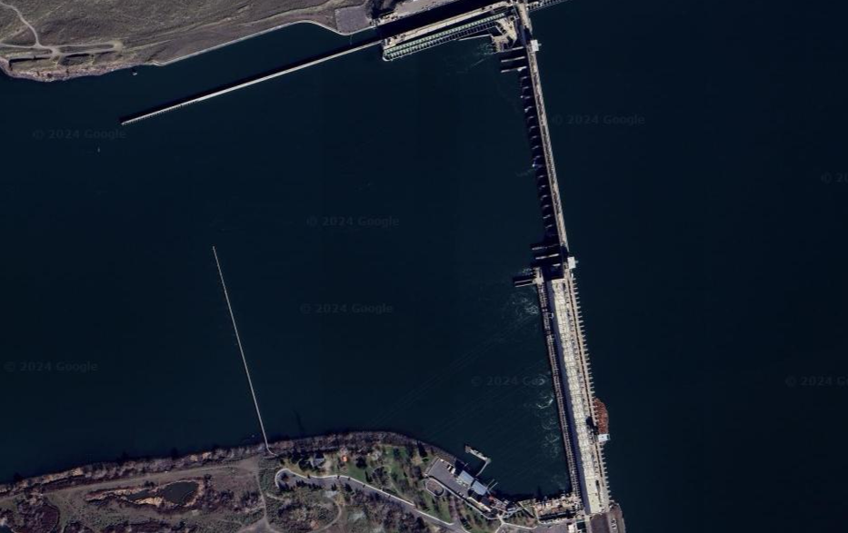
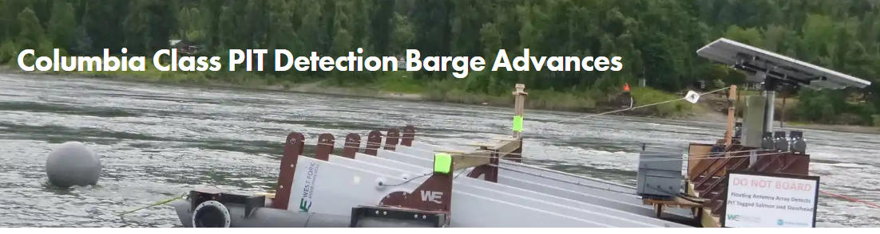
#8 pit barge in forebay or tailrace
PDT Notes:
Pros:
  Quick solution that has been done before
    Less R&D
  Autonomous system
Cons:
  Need it to be placed in a location where most fish are (upstream would be in shipping channel)
  Immediately upstream of spillway would raise dam safety concerns
  April-may peak run time for fish but would need to extend through summer to capture all fish
  Lots of vibration, especially in tailrace
www.westforkenv.com

Slide 7
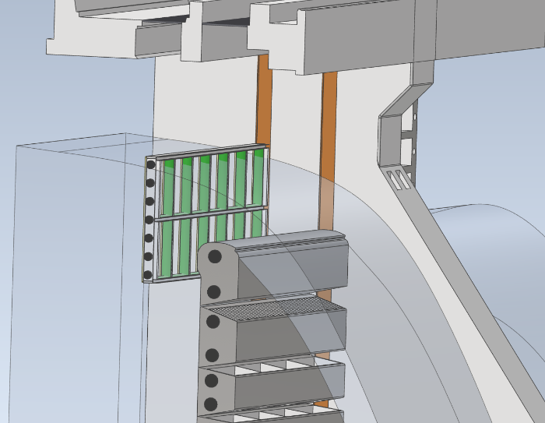
#11 Matrix Antenna PIT detector
PDT Notes:
Pros:
  High detection coverage
  Removable
  Fixed antenna position with no moving parts
    Simple and lower O&M
Cons:
  Possibility of MNA staff having to clear debris from detector; large openings and orientation below the surface should alleviate most of these concerns
  Possible fish avoidance

Slide 8
NEXT STEPS
Scheduled Milestones | Date
Kickoff Meeting | May 2024
Initial Concept Briefing | June 2024
USACE Alternatives Concept Review | September 2024
All PDT Workshop- Concept Screening and further Development | October 2024- at MCN Dam
New Concept Submittal from PSMFC/NOAA | October 2024
** Brief FFDRWG on Initial Findings/ get input from group | November FFDWG
Workshop on refined alternatives/ screening criteria | March 20, 2025
PDT review of alternatives comparison | May 9, 2025
Alternative Costs | June 9, 2025
PDT Selection of recommended plan | July 2, 2025
** Brief FFDRWG on workshop Findings | July 16, 2025
Submittal: Draft Scoping Design Report (SDR) | July 31, 2025
Review Period- All PDT/ FFDRWG | August 2025
Submittal: Final Scoping Design Report (SDR) | September 2025

Slide 9

Questions? / additional concepts?
Notes:
Slide 27 – Questions
I want to thank you again for the opportunity to join you this afternoon.
I wish you much success and look forward to working with you all to restore and sustain a high level of reliability in OUR hydropower infrastructure.

